Slide 1




Next Gen Employability Program
Full Stack Web Development with AI Tools
Team Details – NG_CP_Team_5169
Name: RAGAVI.D
Name: ELLAKIYA.V
Name: LAVANYA.K
Name: SATHIYA.V
College: Adhiparashakthi Engineering College, Chennai

Slide 2

The content is curated from online/offline resources and used for educational purpose only.
Notes:
Speaker would be briefing the students that this content has been prepared for the educational purpose only and is referred from multiple sites which are cited in the last.​​
---------------------------------------------------​​
A disclaimer is a statement or notice that is intended to clarify, limit, or provide information about the scope, limitations, or potential risks associated with certain actions, information, products, services, or content. ​​
​​
​

Slide 3

Project Title
MONTHLY EXPENSE TRACKER
Notes:
In this slide speaker will be introducing the program and its outcomes. The speaker will introduce himself in brief

Slide 4

TABLE OF CONTENT
Problem Statement
Existing System
Proposed System
Objectives of the Project
Introduction
Requirements
Modules Description
Future Enhancements
Conclusion
References
Notes:
This slide, The speaker will talk about the content that we will be covering in this session as follows:
Introduction
Importance of UI/UX in industry
History and Definitions of UI and UX
Key Differences between UI/UX
Use Cases
Significance in Web Development
Use Cases
Visual Design Principles
Design process
Color theory and psychology
Typography and readability
Layout and Spacing
Responsive design basics
Usability and Accessibility
Usability Aspects
Web Content Accessibility Guidelines (WCAG)
Inclusive design practices
Consistency
User Experience
User-Centered Design
User research methods
Interactive Elements and Feedback
Mini Case Study
Discussing a popular UI/UX design
Hands-On
Introduction to Figma for UI/UX design

Slide 5
PROBLEM STATEMENT:
Most people do not track their daily expenses regularly, leading to poor financial management and unnoticed money leaks. Studies show that nearly 70% of individuals lose track of where their money goes, resulting in overspending and difficulty in achieving savings goals. There is a need for a simple and effective tool to help users monitor their finances.
EXISTING SYSTEM:
Current expense tracker apps like Mint, Walnut, and Money Manager have several drawbacks:
Complex interfaces that are difficult to navigate
Excessive advertisements disrupting user experience
Paid subscriptions for advanced features
Poor data visualization making analysis difficult
Internet dependency limiting offline access

Slide 6
MAIN OBJECTIVES:
To design and develop a simple, user-friendly monthly expense tracker application that helps individuals manage their personal finances effectively.
Easy Expense Tracking – Simple interface to add, edit, and delete transactions
Category Management – Organize expenses under Food, Travel, Bills, etc
Visual Analytics – View spending patterns through charts and graphs
Transaction History – Complete record with date-wise grouping and search
Customization – Light/dark theme and currency selection
Mobile Optimization – Phone-like interface for seamless mobile use
Offline Support – Access and use without internet
MAIN OBJECTIVE
To design and develop a simple, user-friendly monthly expense tracker application that helps individuals manage their personal finances effectively.

Slide 7
INTRODUCTION
Managing personal finances is essential in today’s digital world.
Many people find it difficult to track daily income and expenses manually.
Lack of proper tracking leads to overspending and poor budgeting.
The Monthly Expense Tracker helps users monitor income and expenses efficiently.
Provides category-wise tracking of expenses.
Generates reports and visualizations for better financial analysis.
Encourages smart budgeting and disciplined spending habits.
Supports effective monthly financial planning.

Slide 8
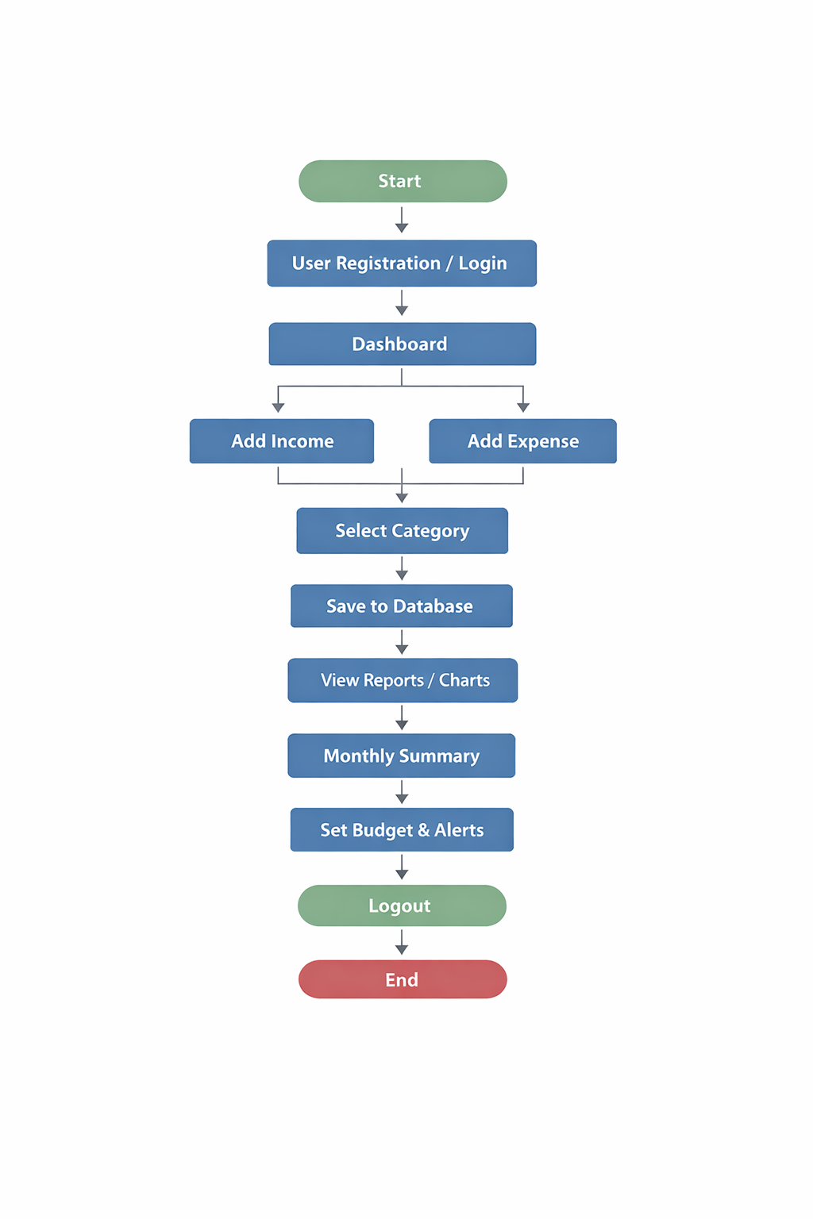
REQUIREMENTS
Hardware Requirements:
Computer / Laptop
Minimum 4GB RAM
Internet Connection
Software Requirements:
Frontend: HTML, CSS, JavaScript
Backend: Django
Database: MySQL
Browser: Chrome / Edge
IDE: VS Code

Slide 9
MODULES
User Login Module: Allows users to register and securely log in to the system.
Income Management Module: Users can add, edit, and view their monthly income details.
Expense Management Module: Users can record daily expenses under different categories like food, rent, transport, etc.
Report & Analysis Module Generates monthly summaries and shows total income, total expenses, and remaining balance.

Slide 10
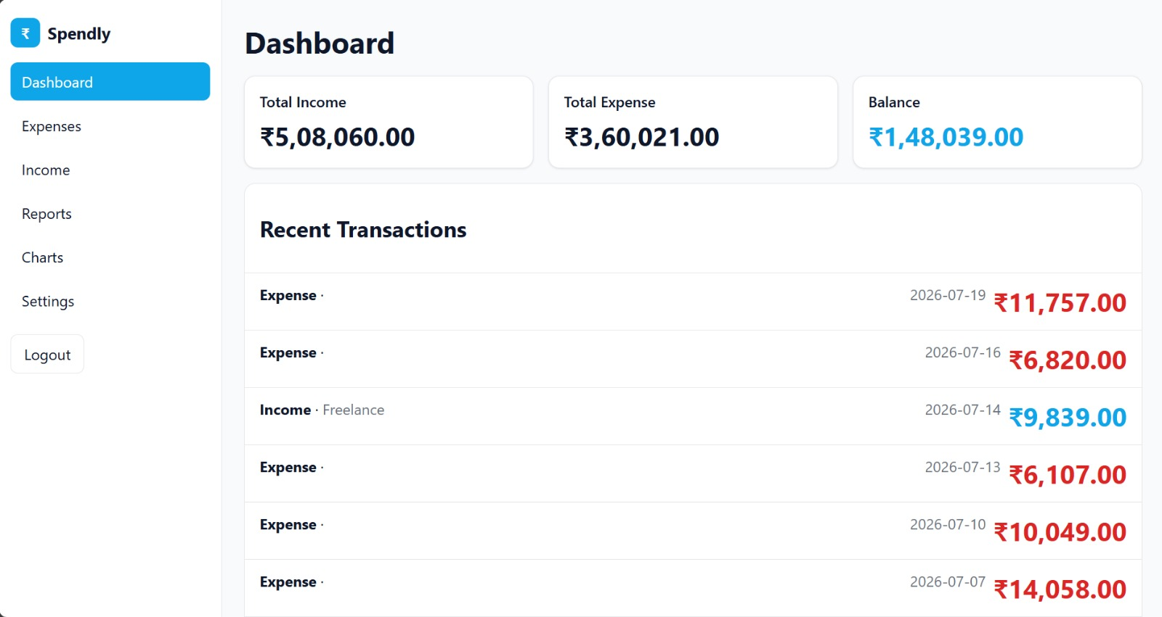
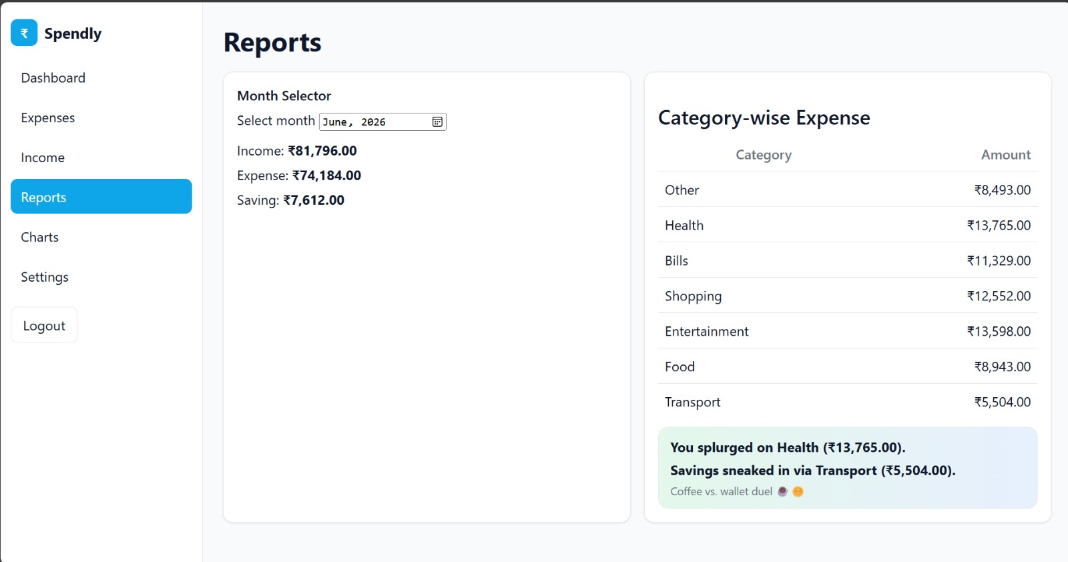
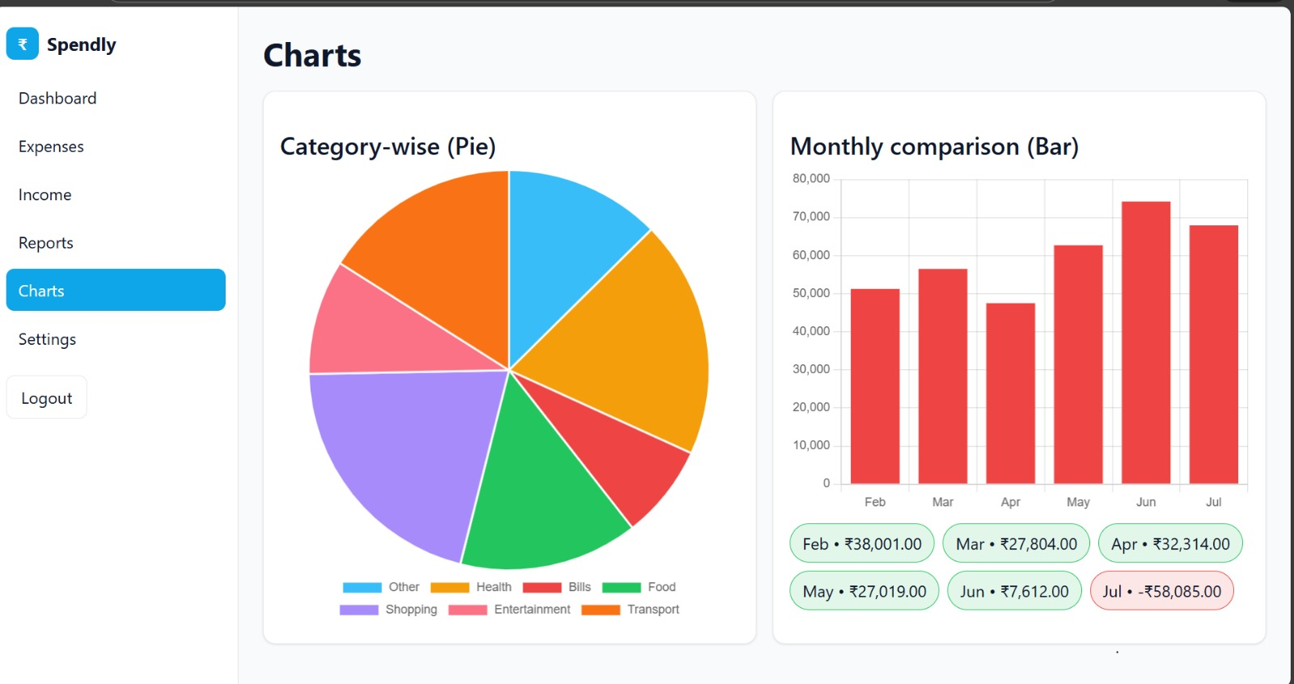
APP OVERVIEW

Slide 11
FUTURE ENHANCEMENTS:
Adding email notifications for monthly expense summary.
Adding AI-based expense prediction to estimate next month’s spending.
Implementing fingerprint or face authentication for extra security.
Adding goal-based savings tracking (example: save ₹10,000 in 3 months).
Integrating UPI / bank transaction auto-import feature.
Adding family/shared account feature where multiple users can track expenses together.

Slide 12
Conclusion:
In conclusion, our Monthly Expense Tracker project provides an easy and effective way for users to monitor their daily and monthly expenses. It helps users record their income and expenses, visualize their spending patterns, and maintain better control over their finances.
Overall, this project supports smart financial planning and encourages users to make better money management decisions. Through this project, we gained practical knowledge about full-stack development and understood how frontend and backend work together in a real-time application. This project also improved our problem-solving skills and gave us hands-on experience in building a complete functional system.

Slide 13
REFERENCES:
https://ijresonline.com/archives/ijres-v10i3p108
https://sciresol.s3.us-east-2.amazonaws.com/IJST/Articles/2015/Issue-Supplementary-2/Article16.pdf
https://ieeexplore.ieee.org/abstract/document/10170735
EXISTING APP:
https://play.google.com/store/apps/details?id=com.droid4you.application.wallet&hl=en_IN
Notes:
This slide, The speaker will talk about the content that we will be covering in this session as follows:
Introduction
Importance of UI/UX in industry
History and Definitions of UI and UX
Key Differences between UI/UX
Use Cases
Significance in Web Development
Use Cases
Visual Design Principles
Design process
Color theory and psychology
Typography and readability
Layout and Spacing
Responsive design basics
Usability and Accessibility
Usability Aspects
Web Content Accessibility Guidelines (WCAG)
Inclusive design practices
Consistency
User Experience
User-Centered Design
User research methods
Interactive Elements and Feedback
Mini Case Study
Discussing a popular UI/UX design
Hands-On
Introduction to Figma for UI/UX design

Slide 14
THANKYOU !

